Slide 1
Outline
Concept of Causality

Slide 2

Concept of Cause, Causal relationships
Most social scientific studies attempt to provide some kind of causal explanation.
A study on an intervention to prevent child abuse is trying to draw a connection between the intervention and changes in child abuse.

Slide 3
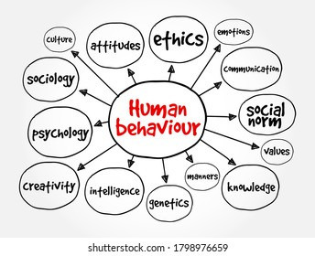
Causality refers to the idea that one event, behaviour, or belief will result in the occurrence of another, subsequent event, behaviour, or belief.
In other words, it is about cause and effect.
It seems simple, but you may be surprised to learn there is more than one way to explain how one thing causes another.
3

Slide 4

In causality, that means that in order to try to understand what caused what
An independent variable is the cause, and a dependent variable is the effect. Why are they called that?
Dependent variables depend on independent variables. If all of that gets confusing, just remember this graphical relationship:

Slide 5
Independent
Variable
Dependent
Variable
influences
X
Y

Slide 6
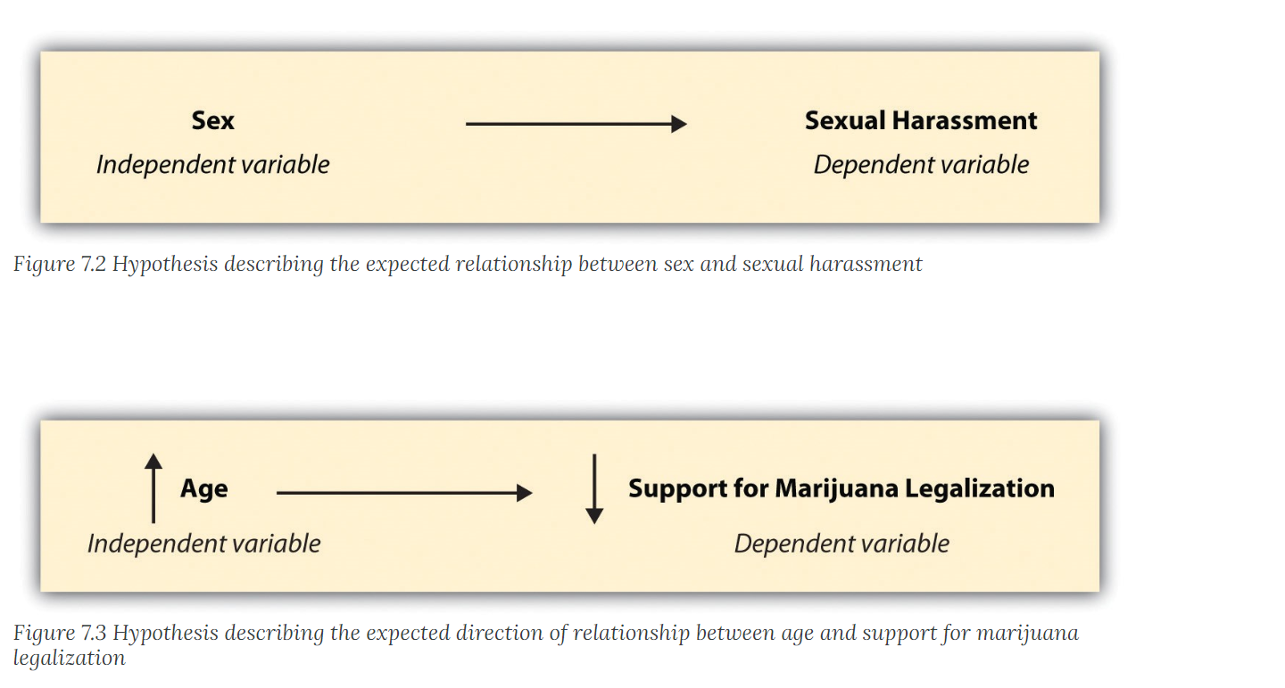
A hypothesis is a statement describing a researcher’s expectation regarding what she anticipates finding.
Hypotheses in quantitative research are a nomothetic causal relationship that the researcher expects to demonstrate.

Slide 7
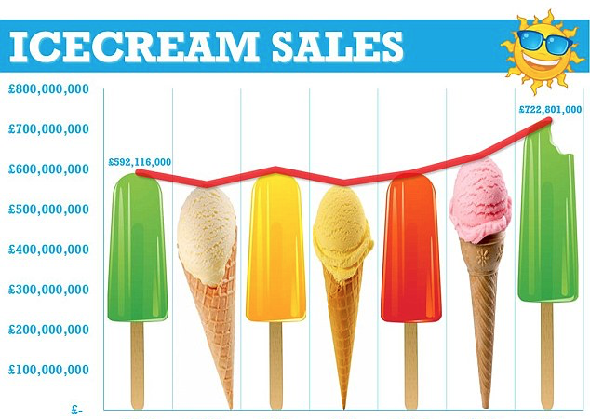
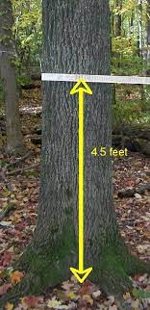
Correlation examples
For example, if they are fully correlated this will imply that the value of first will increase (or decrease) in the same amount (percentage) as the value of second.
Causality
The relation between something that happens and the thing that causes it . The first thing that happens is the cause and the second thing is the effect .
It is very important to know that correlation does not mean causality. While correlation is a mutual connection between two or more things, causality is the action of causing something.
Causality examples
For example, there is a correlation between ice cream sales and the temperature, as you can see in the chart below .

Slide 8
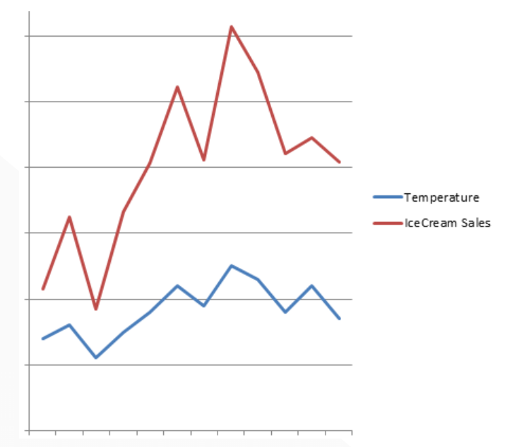

Slide 9
Extraneous variable:
Independent variables that are not related to the purpose of the study, but may affect the dependent variable are termed as extraneous variables.
Suppose the researcher wants to test the hypothesis that there is a relationship between children’s gains in social studies achievement and their self-concepts.

Slide 10
In this case self-concept is an independent variable and social studies achievement is a dependent variable.
Intelligence may as well affect the social studies achievement, but since it is not related to the purpose of the study undertaken by the researcher, it will be termed as an extraneous variable.
A study must always be so designed that the effect upon the dependent variable is attributed entirely to the independent variable(s), and not to some extraneous variable or variables.
7-10

Slide 11
Control
One important characteristic of a good research design is to minimise the influence or effect of extraneous variable(s).
The technical term ‘control’ is used when we design the study minimising the effects of extraneous independent variables. In experimental researches, the term ‘control’ is used to refer to restrain experimental conditions.

Slide 12
Uses of Casual Research
To understand which variables are the cause (independent variables) and which variables are the effect (dependent variables) of a phenomenon
To determine the nature of the relationship between the causal variables and the effect to be predicted
METHOD: Experiments

Slide 13
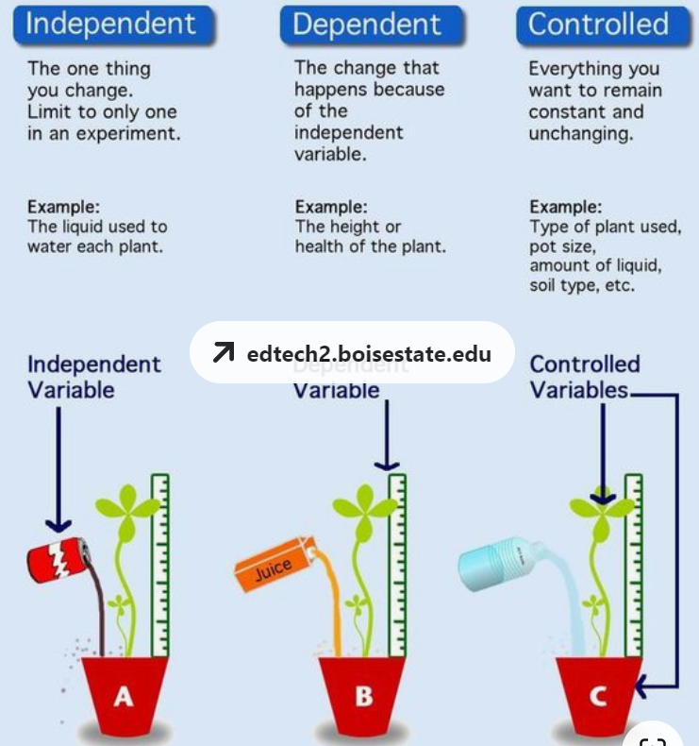
edtech2.boisestate.edu
7-13

Slide 14
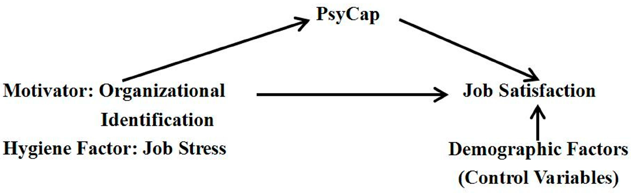
https://doi.org/10.3390/ijerph121214973
7-14

Slide 15
Confounded relationship:
When the dependent variable is not free from the influence of extraneous variable(s), the relationship between the dependent and independent variables is said to be confounded by an extraneous variable(s)

Slide 16
Confounding means the distortion of the association between the independent and dependent variables because a third variable is independently associated with both. A causal relationship between two variables is often described as the way in which the independent variable affects the dependent variable
7-16

Slide 17
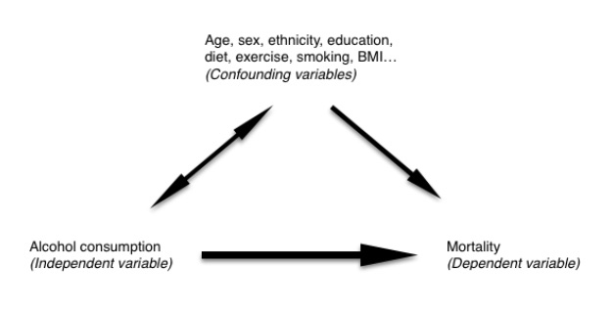
7-17

Slide 18
Research hypothesis:
When a prediction or a hypothesised relationship is to be tested by scientific methods, it is termed as research hypothesis.
The research hypothesis is a predictive statement that relates an independent variable to a dependent variable. Usually a research hypothesis must contain, at least, one independent and one dependent variable. Predictive statements which are not to be objectively verified or the relationships that are assumed but not to be tested, are not termed research hypotheses.

Slide 19
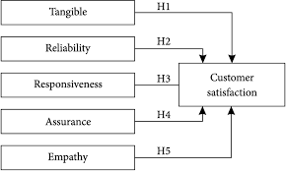
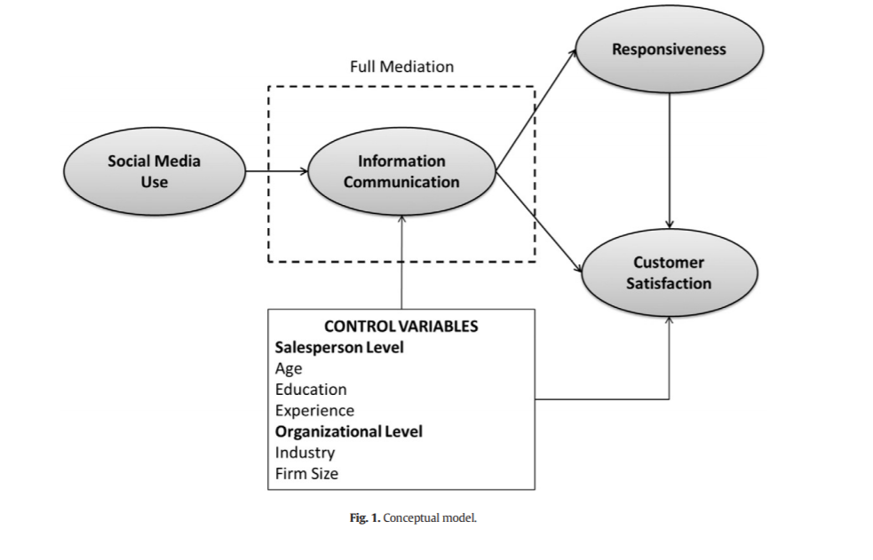
Agnihotri, R., Dingus, R., Hu, M. Y., & Krush, M. T. (2016). Social media: Influencing customer satisfaction in B2B sales. Industrial Marketing Management, 53, 172-180.
7-19

Slide 20
Concepts in Research Design
Experimental and non-experimental hypothesis-testing research:
When the purpose of research is to test a research hypothesis, it is termed as hypothesis-testing research. It can be of the experimental design or of the non-experimental design.
Research in which the independent variable is manipulated is termed ‘experimental hypothesis-testing research’ and a research in which an independent variable is not manipulated is called ‘non-experimental hypothesis-testing research’.

Slide 21
For instance, suppose a researcher wants to study whether intelligence affects reading ability for a group of students and for this purpose he randomly selects 50 students and tests their intelligence and reading ability by calculating the coefficient of correlation between the two sets of scores.
This is an example of non-experimental hypothesis-testing research because herein the independent variable, intelligence, is not manipulated.

Slide 22
But now suppose that our researcher randomly selects 50 students from a group of students
who are to take a course in statistics and then divides them into two groups by randomly assigning 25 to Group A, the usual studies programme, and 25 to Group B, the special studies programme.
At the end of the course, he administers a test to each group in order to judge the effectiveness of the training programme on the student’s performance-level.
This is an example of experimental hypothesis-testing research because in this case the independent variable, viz., the type of training programme, is manipulated

Slide 23
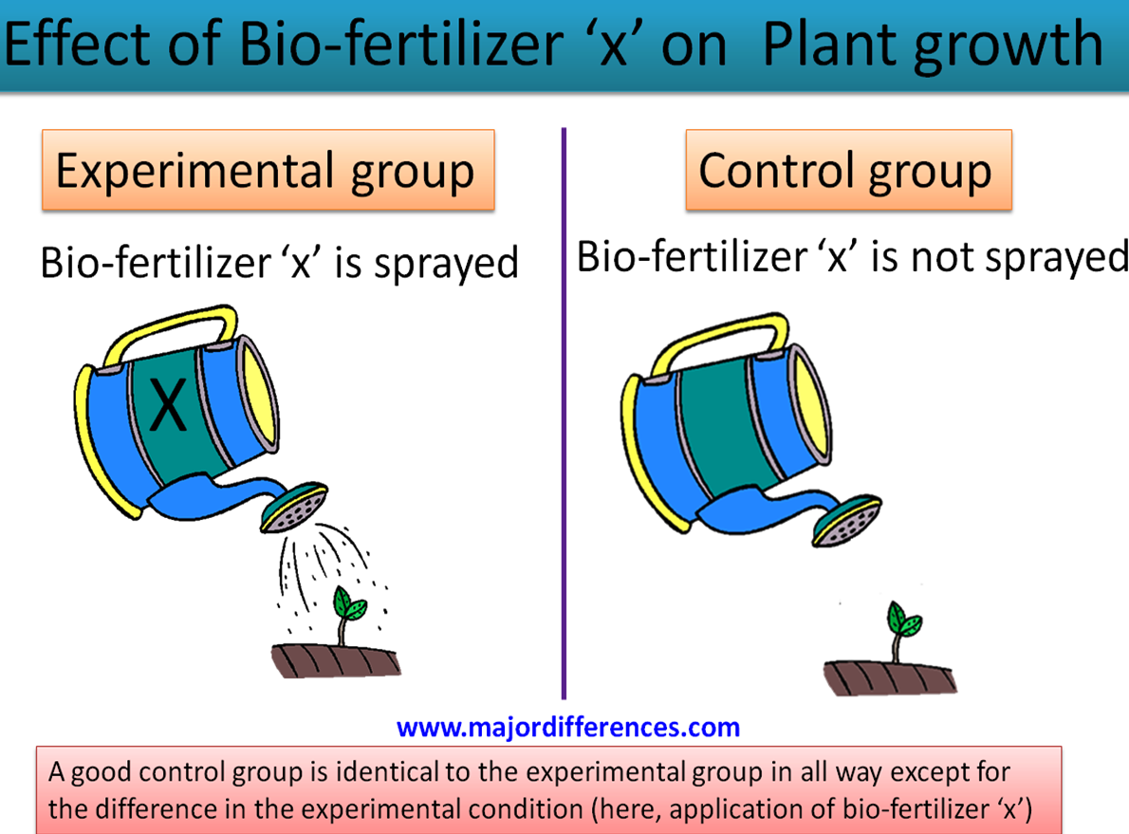
Concepts in Research Design
Experimental and control groups: In an experimental hypothesis-testing research when a group is exposed to usual conditions, it is termed a ‘control group’, but when the group is exposed to some novel or special condition, it is termed an ‘experimental group’.
It is possible to design studies which include only experimental groups or studies which include both experimental and control groups.
Treatments: The different conditions under which experimental and control groups are put are usually referred to as ‘treatments’.

Slide 24

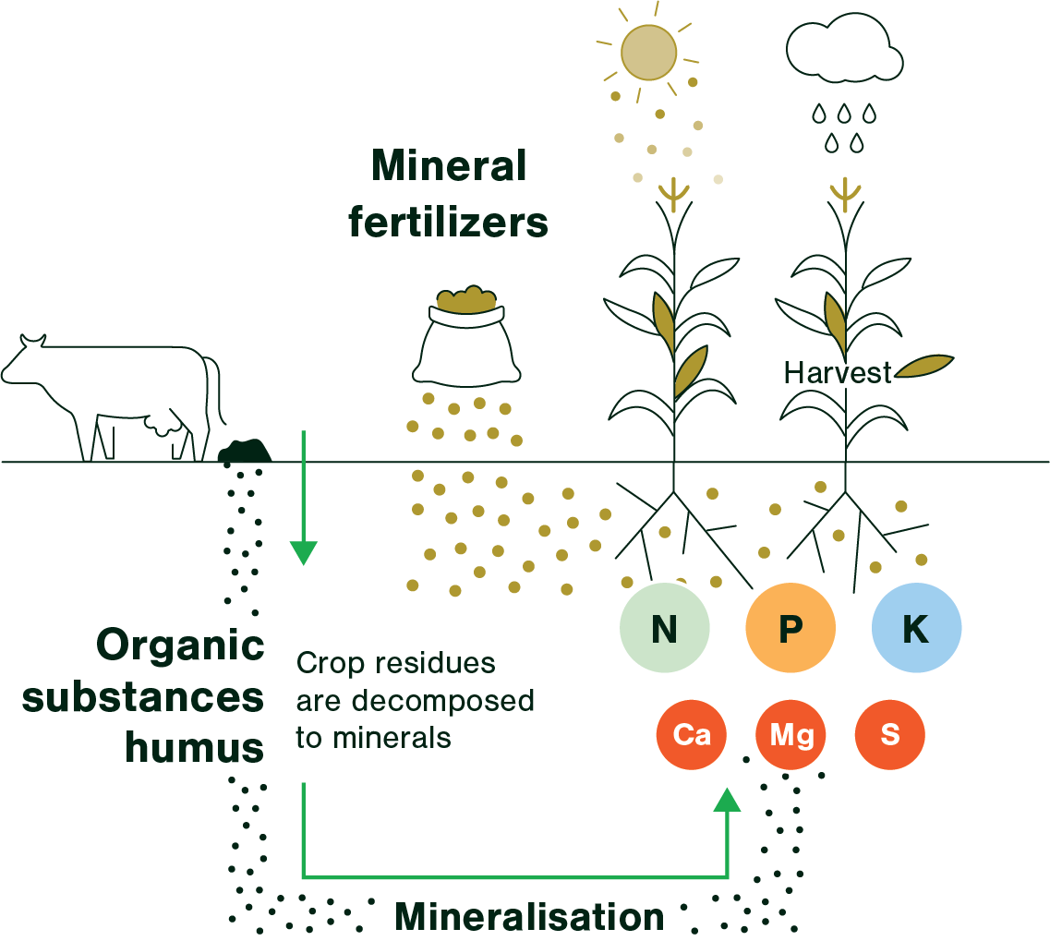
In the illustration taken above,
the two treatments are the usual studies programme and the special studies programme.
Similarly, if we want to determine through an experiment the comparative impact of three varieties of fertilizers on the yield of wheat, in that case the three varieties of fertilizers will be treated as three treatments
7-24

Slide 25
Experiment: The process of examining the truth of a statistical hypothesis, relating to some research problem, is known as an experiment. For example, we can conduct an experiment to examine the usefulness of a certain newly developed drug.

Slide 26
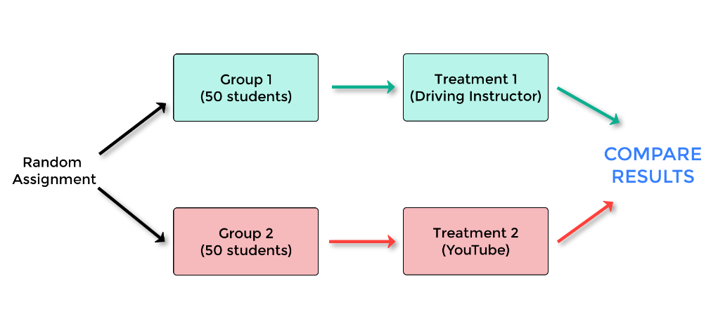
Experiments can be of two types viz.,
absolute experiment and comparative experiment.
If we want to determine the impact of a fertilizer on the yield of a crop, it is a case of absolute experiment;
but if we want to determine the impact of one fertilizer as compared to the impact of some other fertilizer, our experiment then will be termed as a comparative experiment.
Often, we undertake comparative experiments when we talk of designs of experiments.
7-26

Slide 27

Important Experimental Designs

Slide 28
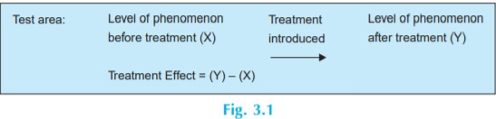
Informal Experimental Designs
Before-and-after without control design:
In such a design a single test group or area is selected and the dependent variable is measured before the introduction of the treatment.
The treatment is then introduced and the dependent variable is measured again after the treatment has been introduced.
The effect of the treatment would be equal to the level of the phenomenon after the treatment minus the level of the phenomenon before the treatment. The main difficulty of such a design is that with the passage of time considerable extraneous variations may be there in its treatment effect.
Source and Adoption: C R Kothari, Research Methodology, New Age International

Slide 29
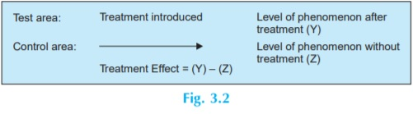
Informal Experimental Designs
After-only with control design:
In this design two groups or areas (test area and control area) are selected and the treatment is introduced into the test area only.
The dependent variable is then measured in both the areas at the same time. Treatment impact is assessed by subtracting the value of the dependent variable in the control area from its value in the test area.
The basic assumption in such a design is that the two areas are identical with respect to their behavior towards the phenomenon considered. If this assumption is not true, there is the possibility of extraneous variation entering into the treatment effect. However, data can be collected in such a design without the introduction of problems with the passage of time.
Source and Adoption: C R Kothari, Research Methodology, New Age International

Slide 30
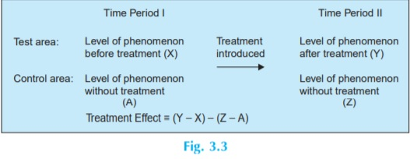
Informal Experimental Designs
Before-and-after with control design:
In this design two areas are selected and the dependent variable is measured in both the areas for an identical time-period before the treatment.
The treatment is then introduced into the test area only, and the dependent variable is measured in both for an identical time-period after the introduction of the treatment.
The treatment effect is determined by subtracting the change in the dependent variable in the control area from the change in the dependent variable in test area.
Source and Adoption: C R Kothari, Research Methodology, New Age International

